Slide 1

SMARTINTERNZ Smart Agriculture System based on IOT
Project demonstration
By
Mr.sai naveen thota

Slide 2




Tools used

Slide 3
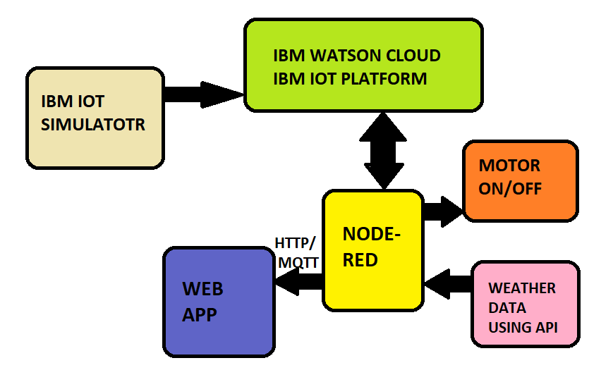
Block diagram

Slide 4
Thank You

